Slide 1

Project: Devil May Drive
Car rental

Slide 2




Our team
Alexander Vladimirov Dyanov
CSS developer
Dimitar Plamenov Nyagalov
Designer
Martin Atanasov Zhelev
Leader
Georgi Ivaylov Nikolov
HTML developer

Slide 3
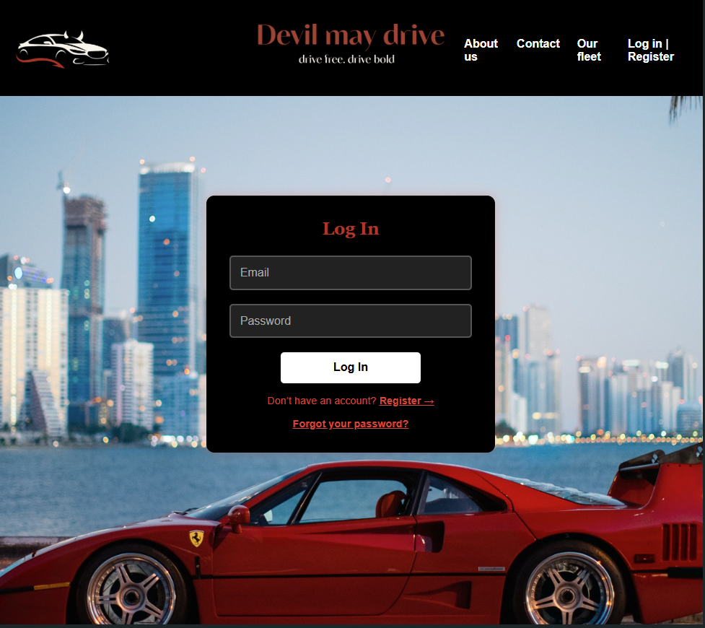
Our goal
Our goal with Devil-May-Drive is to build an immersive and dynamic car rental platform that goes beyond utility and becomes an experience. We aim to blend sleek design, smooth navigation, and high-performance vehicle options to create a site that feels like a digital garage for car enthusiasts. By drawing inspiration from luxury, muscle and sport cars, we want to capture the thrill and personality of each ride. The result is a visually compelling, user-friendly, responsive site that makes choosing and renting a car as exciting as driving one.

Slide 4









technologies
цж

Slide 5

Lets start the demo

Slide 6
Thanks for the attention

